Slide 1
MOD 2 – CH 2 – DESIGN OF ALU
Debkumar Chowdhury
Assistant Professor
CSE

Slide 2
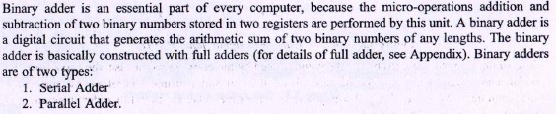
Introduction of Binary Adder

Slide 3
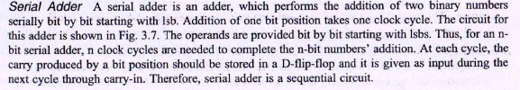
Serial Adder

Slide 4
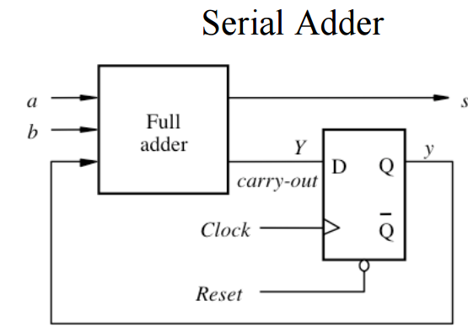
Serial Adder - Diagram

Slide 5
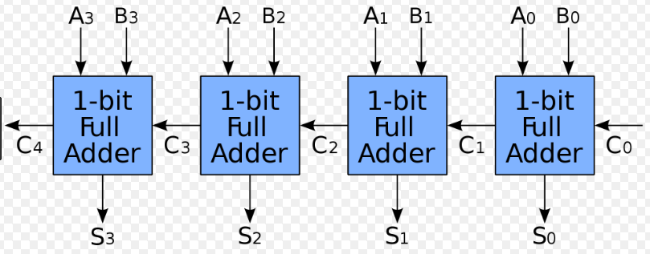
CPA

Slide 6
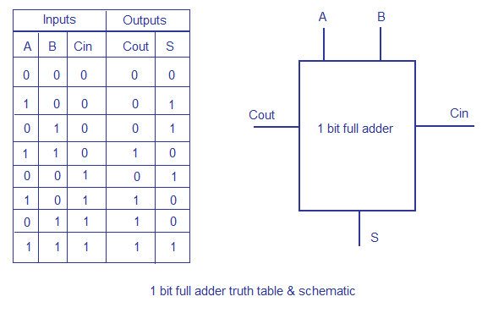
CPA – FA Truth Table

Slide 7
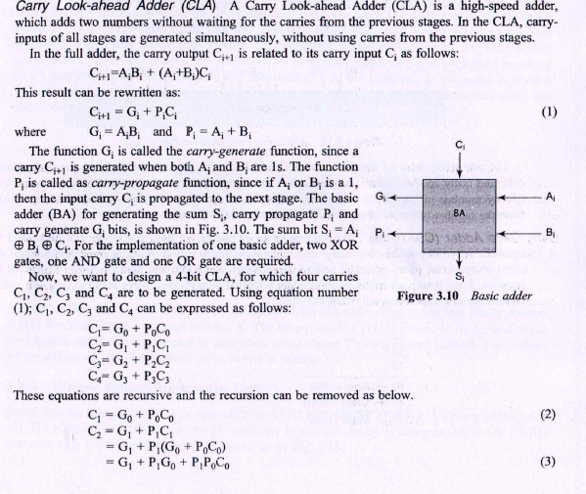
CLA

Slide 8
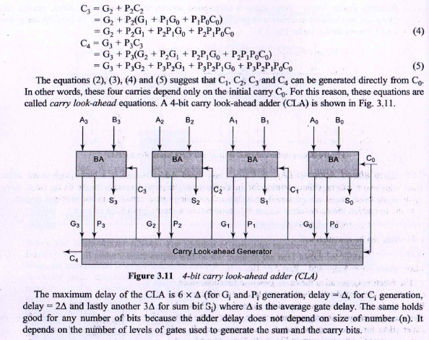
CLA

Slide 9
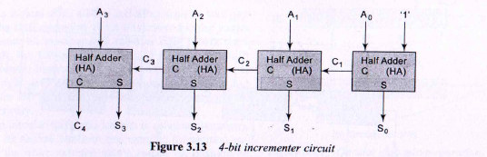
Binary Incrementor unit

Slide 10
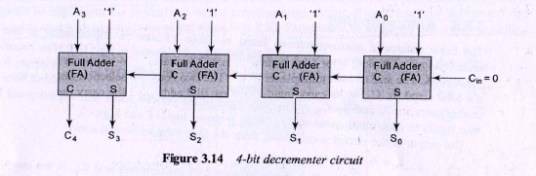
Binary Decrementor unit

Slide 11
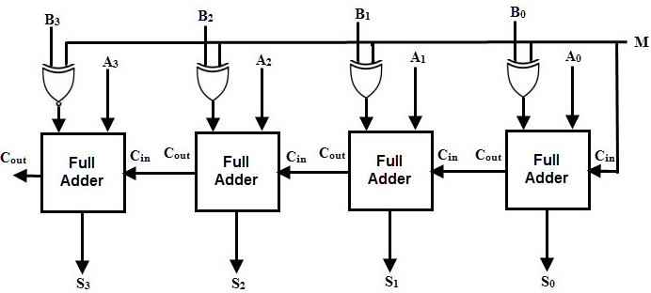
Adder Subtractor Composite Unit

Slide 12
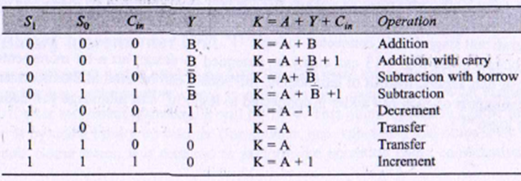
Arithmetic Unit – Truth Table

Slide 13
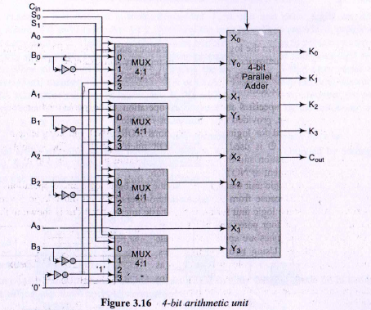
Arithmetic Unit – Block Diagram

Slide 14
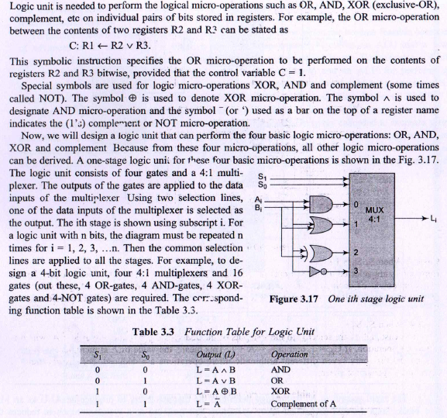
Logical Unit

Slide 15
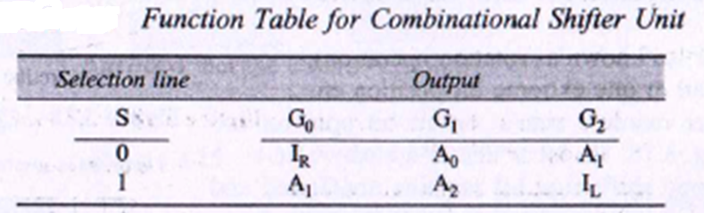
Shifter Unit – Truth Table

Slide 16
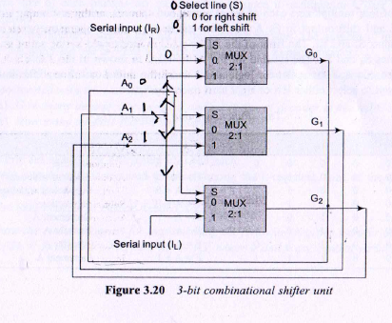
Shifter Unit – Block Diagram

Slide 17
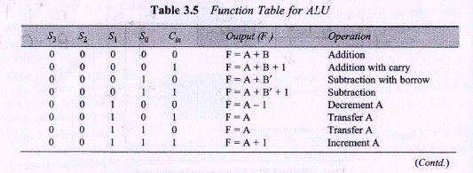
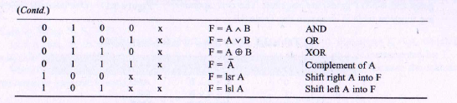
ALU - Truth Table

Slide 18
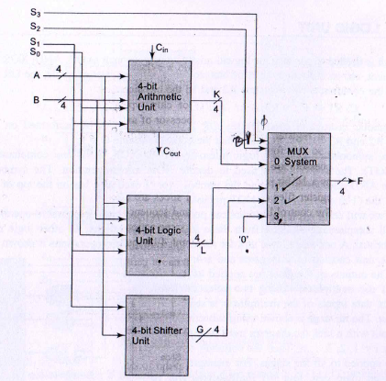
ALU – Block Diagram

Slide 19
*****END*****

